Slide 1
BRICKS
Brick- structural clay products, manufactured as standard units, used in building construction.
Oldest building material
Leading building material- because of its strength, low cost and easy availability
Made from soil- hence properties depends on properties of soil.
Great wall of China –made from both country burnt and sundried bricks.

Slide 2
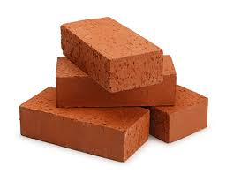
Constituents of brick earth
Alumina- 20-30%-imparts plasticity to earth so that it can be moulded.
Excess alumina- bricks shrink and warp
Silica-50 to 60%-prevents warping and shrinking. Imparts uniform shape to the bricks.
Lime-not exceeding 5%
Assists the fusion of sand in high temp at kiln.

Slide 3
Oxides of iron- help to bind particles and also gives red colour to brick.
Magnesia- only in small extent
Decreases shrinkage

Slide 4
Size of bricks- indian standard brick-19cmx 19cmx 19cm
With mortar joint- 20cmx20cmx20cm
non-modular sizes of the bricks -23cmx11cmx7cm

Slide 5
Classification of Bricks Clay bricks can be classified according to their varieties, qualities, and classes.
1.1 Common Bricks Common burnt clay bricks, which are accepted for use in general brick work with no special claim for attractive appearances. Walls built with common bricks require rendering or plastering.
1.2 Facing Bricks Quality burnt clay bricks, which give attractive appearance in their color and texture. It is used without rendering, plastering, or other surface treatments.
1.3 Loadbearing Bricks Loadbearing bricks, which can be either common or facing bricks, conform to specified average compressive strength limits depending on their classes as given in table below.

Slide 6
Classification of bricks- Based on British Standard 3921:1965
class | Average Compressive Strength
 | N/mm²
1 | 7.0
2 | 14.0
3 | 20.5
4 | 27.5
5 | 34.5
7 | 48.5
10 | 69.0
15 | 103.5

Slide 7
1.4 Engineering Bricks
Engineering bricks are bricks burnt at exceedingly high temperatures.
They possess a dense and strong semi-vitreous body and conform to the defined limits for strength and water absorption.
They are primarily used in civil engineering works that require high load bearing capacity, good damp-proof, and chemical resisting characteristics.

Slide 8
Engineering | Average Compressive Strength, (No less than) N/mm² U.S.A. | Average Water Absorption, % (No greater than)
A | 69.0 (10,000 psi) | 4.5
B | 48.5 (7,000 psi) | 7.0
* Based on British Standard 3921:1965

Slide 9
Properties and Functional Performances of Brick
Bricks are made from clay by burning it at high temperatures.
The action of heat gives rise to a sintering process that causes the clay particles to fuse and develops extremely strong ceramic bonds in the burnt clay bodies.
Such bonds are highly stable.
As a result, bricks can withstand the severe weathering actions and are inert to almost all normal chemical attacks.

Slide 10
1. Strength
Bricks are well-known for their high compressive strength. Their compressive strength depends on:
the raw materials used,
the manufacturing process, and
the shape and size.
Bricks made by a de-aerated extruder and fired to sufficiently high temperature can easily withstand a compressive pressure exceeding 28 N/mm² (4,000 psi). They are suitable for almost all structural building applications

Slide 11
2.Aesthetic appeal
Brick possesses the natural and pleasant colours of burnt clay.
Its colour formation is achieved through a complicate physical chemical reaction during the firing process.
In contrast to colour of stained body, brick colour is permanent and will not be faded during weathering process.
Different clay compositions, firing temperatures or kiln atmosphere can lead to different colours of the burnt products.
By proper control of these factors, bricks can be made to exhibit endless variety of natural and attractive colours.

Slide 12
Besides its richness in colour, bricks can be made to various textures.
It is the combination of colour and texture that gives brick such distinctive feature which is everlasting and meadows with age.
In view of the high cost to maintain the appearance of a building, the unique features of brick become an unparalleled advantage to housing design.

Slide 13
3 Porosity
Porosity of building material is an important factor to consider in respect its performance and applications.
the porosity of brick is attributed to its fine capillaries.
By virtue of the capillary effect, the rate of moisture transport in the brick is ten times faster than in other building materials.
Moisture is released during day-time and re-absorbed during night-time.
The ability to release and re-absorb moisture (a "breathing" process) by capillary effect is one of the most useful properties of brick that helps to regulate the temperature and humidity of atmosphere in a house.
This distinctive property makes brick an admirable building material, particularly suitable for houses in the tropics.

Slide 14
Experiment results show that bricks with water absorption rate at 8% is 10 times more durable in resisting salt attack than that with water absorption rate at 20%.
Well burnt brick has a normal water absorption rate less than 10% in contrast to that of concrete block and cement mortar exceeding 15%.
This explains why brick walls require comparatively minimum maintenance in the course of time.
To mitigate the adverse effects but at the same time retain the advantages associated with porosity, the rate of water absorption of facing bricks for masonry brickwork should preferable be maintained around 10%.

Slide 15
Fire Resistance
Brick is inherent with excellent fire resistance.
A 100 mm brickwork with 12.5 mm normal plastering will provide a fire-resistance of 2 hours and a 200 mm non-plastered brickwork will give a maximum rating of 6 hours for non-load bearing purposes.
Brick can support considerable load even when heated to 1000ºC in contrast to concrete wall at only up to 450ºC due to loss of water of hydration.
It is a fact that the non-combustibility of brick helps to promote its use in building houses against fire.

Slide 16
5 Sound Insulation Brick wall shows good insulation property due to its dense structure.
The sound insulation of brickwork is generally
- 45 decibels for a 4-1/2 in. thickness
- 50 decibels for a 9-in. thickness for the frequency range of 200 to 2,000 Hz.

Slide 17
6. Thermal Insulation
Brick generally exhibits better thermal insulation property than other building materials like concrete.
Perforation can improve the thermal insulation property of bricks to some extent.
Besides, the mass and moisture of bricks help to keep the temperature inside the house relatively constant.

Slide 18
In other words, bricks absorb and release heat slowly and thus keep the house cool during daytime and warm during nighttime.
Energy saving of a brick house is remarkable.
A study commissioned by the Brick Institute of America had demonstrated that a brick house can save energy up to 30% when compared to that built of wood.

Slide 19
Typical Thermal Conductivities of Various Building Materials
Material | Btu/(sq.ft.-hr-F/in.) | W/mK
Sand & gravel aggregate (dry) | 9.0 | 1.30
Cement Mortar | 5.0 | 0.70
Concrete (1:4) | 5.28 | 0.77
Concrete Block (1:5) (four Oval-core) | 5.2 | 0.75
Concrete Block (1:10) (four Oval-core) | 6.6 | 0.95
Solid Brick (density:1925kg/m³) | 5.0 | 0.72
Perforated Brick (25% perforation density:1400kg/m³) | 4.0 | 0.58

Slide 20
7 Wear resistance
The wear resistance of a substance depends on its particulate bonds. Bricks shows high wear resistance because of its extremely strong ceramic bonds formed by the effect of heat at high temperature.

Slide 21
8 .Efflorescence
Efflorescence is a phenomenon that soluble slats dissolved in water are carried, deposited and gradually accumulated on brick surfaces to form an unsightly scum.
The soluble salts may be originated from the raw material of bricks.
But in most cases, efflorescence is caused by salts from the external sources such as ground water, contaminated atmosphere, mortar ingredients and other materials in contacts with the bricks.

Slide 22
9 Flexibility in Applications
Brick is used for an extremely wide range of applications in an equally extensive range of building and engineering structures.
In particular, it can be used for load bearing structures which greatly simply the construction process so as to save materials, time and labour.
Besides, brick can be make into convenient shape and size to facilitate the construction work.
It is very flexible and handy in application almost everywhere.

Slide 23
10 Durability
Brick is extremely durable and perhaps is the most durable man-made structural building materials so far.
There has been numerous ancient brick-building standing for centuries as a testimony of the endurance of burnt-clay brick.

Slide 24
Classification of bricks
Sundried bricks &Burnt bricks
Burnt bricks:
First class
Second class
Third class
Kiln rejects: zhama bricks and pila bricks

Slide 25
First class bricks
Well burnt
Table moulded
Red or copper colour
Uniform size and shape
Sharp well defined edges
Smooth surface
Without containing any flaws, cracka, stone, grit
Used for construction work of superior quality/permanent nature

Slide 26
Characteristics of first class bricks
Reasonably hard, so that scratch with finger nail leave no mark
On being struck with another brick –produce clear metallic sound
On being fracture, the interior surface of such a brick shows a uniform and compact texture.
They do not absorb water more than 10% of the dry weight
They have a minimum crushing strength of 10.5N/mm2
No efflorescence on surfaces

Slide 27
Second class bricks
Same as 1st class, but they may have fine cracks and mild distortion.
Either well burnt or slightly over burnt.
Emit ringing sound when struck against each other
Rectangular in shape with well defined and sharp edges
May have slight irregularity of sizes which can be covered in the courses.
Clean surfaces
Perfect and free from cracks, but may have slight chips and flows.
Water absorption-less than 22% on soaking in water for 24 hours
Minimum crushing strength-7 N/mm2

Slide 28
Eses-2nd class bricks
Masonry construction where the face wall are plastered
Construction of load bearing walls of single storeyed buildings
As brick ballast in RCC work and in lime concrete

Slide 29
Third class
Ground moulded
Burnt in clamps
May be table moulded also, but slightly under burnt

Slide 30
Characteristics:
Slightly under burnt
Relatively soft and light coloured
Emit dull sound when struk against each other
Need not be of uniform size, may be slightly distorted
Irregularities should be tolerable so that masonry courses are uniform
Do not have sharp edges and corners
Show intensive sign of efflorescence
Texture may not be uniform, it may show pebbles on freshly fractured face.
Water abs-20 to 25 %
Minimum compressive str.-3.5 N/mm2

Slide 31
uses
Unimportant works
Construction of wall of low height where loads are much less-huts , sheds etc.
Boundary walls
Construction in the area where rainfall is not heavy

Slide 32
Kiln rejects
Zhamas- over burnt
Get fused more being near the fire in the kiln
Have very irregular shape
Not used for construction of normal engineering works
Dark colour, brittle, having irregular, hard masses.
May be used for road soling, concrete aggregates, road metal.

Slide 33
Pilas-
Under burnt/ half burnt
Yellow colour
Very poor in strength
Easily broken when dropped
used as surkhi

Slide 34
Classification &specification
Class of bricks | Min. comp.str(N/mm2) | Min. abs. in 24 hrs(% of dry wt.) | efflorescence | Tolerance in dimension(%) +/- | Shape and other properties
HI | 44 | 5 | NO | 3 | Metallic sound, smooth, rectangular
HII | 44 | 5 | NO | 8 | Slight deformation in shape
FI | 17.5 | 12 | VERY LITTLE | 3 | metallic sound, smooth, rectangular
FII | 17.5 | 12 | VERY LITTLE | 8 | Slight deformation in shape
I | 7 | 20 | VERY LITTLE | 3 | metallic sound, smooth, rectangular
II | 7 | 20 | VERY LITTLE | 8 | Slight deformation in shape
LI | 3.5 | 25 | VERY LITTLE | 3 | metallic sound, smooth, rectangular
LII | 3.5 | 25 | VERY LITTLE | 8 | Slight deformation in shape

Slide 35
Size, weight, colour
Size: 190mmx90mmx90mm
Normal size of Modular bricks- 200mmx100mmx100mm
Weight-3-3.5 kg
Colour: depends-
Natural colour of clay and chemical composition
Natural colour of sand used during moulding
State of dryness before burning
Types of fuel used for burning
Quantity of air during burning
Temperature attained during burning

Slide 36
Colour of bricks
colour | Responsible constituents
Red | Iron
bright red | Large proportions of iron oxide
Dark blue or purple | Large proportions of iron oxide burning at high temp
Yellow or orange | Iron and magnesia
Brown | Lime in excess
Bluish green | Alkalies
Cream | Little lime and iron
White | Pure clay free from iron, clay with chalk
Black | Manganese and large proportions of iron

Slide 37
Qualities of good brick
Depends on:
chemical composition of moulded clay
Preparation of clay
Method of moulding
Care taken during moulding
Method of drying and care taken during drying
Method of burning and degree of burning

Slide 38
tests
Absorption
Crushing strength
Hardness
Presence of soluble salts
Shape and size
Soundness
structure

Slide 39
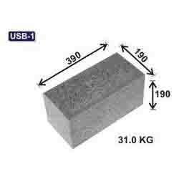
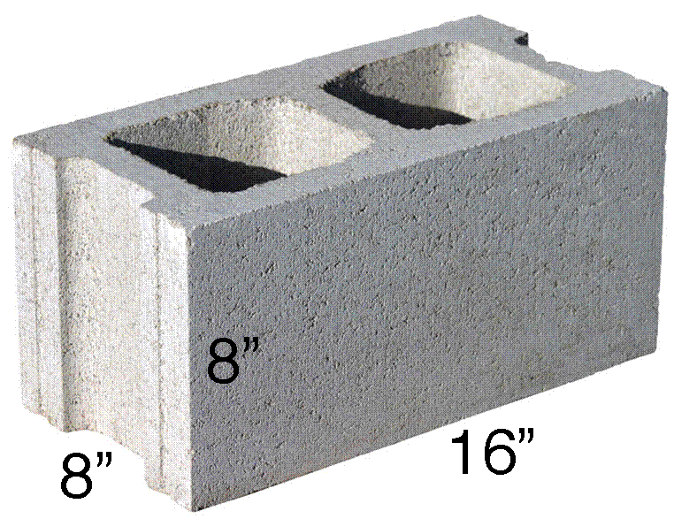
Cement blocks

Slide 40
Cement blocks
Concrete blocks are made from cast concrete
e.g. Portland cement and aggregate, usually sand and fine gravel for high-density blocks.
primarily used as a building material in the construction of walls.
It is sometimes called a concrete masonry unit (CMU).
A concrete block is one of several precast concrete products used in construction.

Slide 41
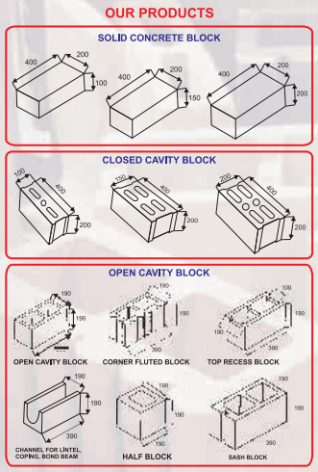
Different types

Slide 42
The term precast refers to the fact that the blocks are formed and hardened before they are brought to the job site.
Most concrete blocks have one or more hollow cavities, and their sides may be cast smooth or with a design.
In use, concrete blocks are stacked one at a time and held together with fresh concrete mortar to form the desired length and height of the wall.

Slide 43
Concrete mortar was used by the Romans as early as 200 B.C. to bind shaped stones together in the construction of buildings.
During the reign of the Roman emperor Caligula, in 37-41 A.D. , small blocks of precast concrete were used as a construction material in the region around present-day Naples, Italy.
Much of the concrete technology developed by the Romans was lost after the fall of the Roman Empire in the fifth century.
It was not until 1824 that the English stonemason Joseph Aspdin developed portland cement, which became one of the key components of modern concrete.

Slide 44
The first hollow concrete block was designed in 1890 by Harmon S. Palmer in the United States.
After 10 years of experimenting, Palmer patented the design in 1900

Slide 45
Raw Materials
The concrete commonly used to make concrete blocks is a mixture of powdered portland cement, water, sand, and gravel.
This produces a light gray block with a fine surface texture and a high compressive strength.
A typical concrete block weighs 17.2-19.5 kg.
the concrete mixture used for blocks has a higher percentage of sand and a lower percentage of gravel and water than the concrete mixtures used for general construction purposes.
This produces a very dry, stiff mixture that holds its shape when it is removed from the block mold

Slide 46
If granulated coal or volcanic cinders are used instead of sand and gravel, the resulting block is commonly called a cinder block.
This produces a
dark gray block
with a medium-to-coarse surface texture,
good strength,
good sound
-deadening properties,
a higher thermal insulating value than a concrete block.
A typical cinder block weighs 11.8-15.0 kg.

Slide 47
Sizes and structure
Concrete blocks may be produced with hollow centers to reduce weight or improve insulation.
The use of block work allows structures to be built in the traditional masonry style with layers (or courses) of staggered blocks. Blocks come in many sizes.
the most common nominal size is
16 in × 8 in × 8 in (410 mm × 200 mm × 200 mm); the block measures a 3/8 in shorter, allowing for mortar joints.
440 mm × 215 mm × 100 mm (17.3 in × 8.5 in × 3.9 in) excluding mortar joints.
390 mm × 190 mm × 190 mm (15.4 in × 7.5 in × 7.5 in) excluding mortar joints.

Slide 48
There may be two, three or four cores, although two cores are the most common configuration.
The presence of a core allows steel reinforcing to be inserted into the assembly- greatly increasing its strength.
Reinforced cores are filled with grout (concrete) to secure the reinforcing in proper relationship to the structure, and to bond the block and reinforcing.
The reinforcing is primarily used
to impart greater tensile strength to the assembly,
improving its ability to resist lateral forces such as wind load and seismic forces.

Slide 49
A variety of specialized shapes exist to allow special construction features.
U-shaped blocks or knockout blocks with notches to allow the construction of bond beams or lintelassemblies, using horizontal reinforcing grouted into place in the cavity.
Blocks with a channel on the end, known as "jamb blocks", allow doors to be secured to wall assemblies.
Blocks with grooved ends permit the construction of control joints, allowing a filler material to be anchored between the un-mortared block ends..
A wide variety of decorative profiles also exist.

Slide 50
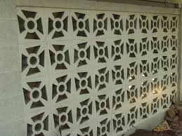
decorative profiles

Slide 51
Concrete masonry units may be formulated with special aggregates to produce specific colors or textures for finish use.
Special textures may be produced by splitting a ribbed or solid two-block unit; such factory-produced units are called "split-rib" or "split-face" blocks.
Blocks may be scored by grooves the width of a mortar joint to simulate different block modules (e.g., an 8" x 16" block may be scored in the middle to simulate 8" x 8" masonry), with the grooves filled with mortar and struck to match the true joints.

Slide 52
Structural properties
Concrete masonry can be used as a structural element in addition to being used as an architectural element.
Ungrouted, partially grouted, and fully grouted walls are the different types of walls allowed.
Reinforcement bars can be used both vertically and horizontally inside the CMU to strengthen the wall and results in better structural performance.
The cells in which the rebar is placed must be grouted for the bars to bond to the wall.
For this reason, high seismic zones typically only allow fully grouted walls in their building codes.

Slide 53
Structural properties
The American design code that guides design engineers in using CMU as a structural system is the Masonry Standards Joint Committee's Building Code Requirements & Specification for Masonry Structures (TMS 402/ACI 530/ASCE 5).
The compressive strength of concrete masonry units and masonry walls varies from approximately 1,000 psi (7 MPa) to 5,000 psi (34 MPa)
based on the type of concrete used to manufacture the unit, stacking orientation, the type of mortar used to build the wall, and other factors.

Slide 54
Uses
Concrete block, when built in tandem with concrete columns and tie beams
reinforced with rebar, is a very common building material for the load-bearing walls of buildings, in what is termed "concrete block structure" (CBS) construction.
concrete foundation and slab with a concrete block wall on the perimeter.
Large buildings typically use copious amounts of concrete block;
for even larger buildings, concrete blocks supplement steel I-beams.
Tilt-wall as well as steel frame construction are both to some extent replacing CBS for some large structures, particularly those more than seven storeys.

